Slide 1

Marketing Mix Modelling
Dr. Priyanka Shrivastava

Slide 2

Agenda

Slide 3
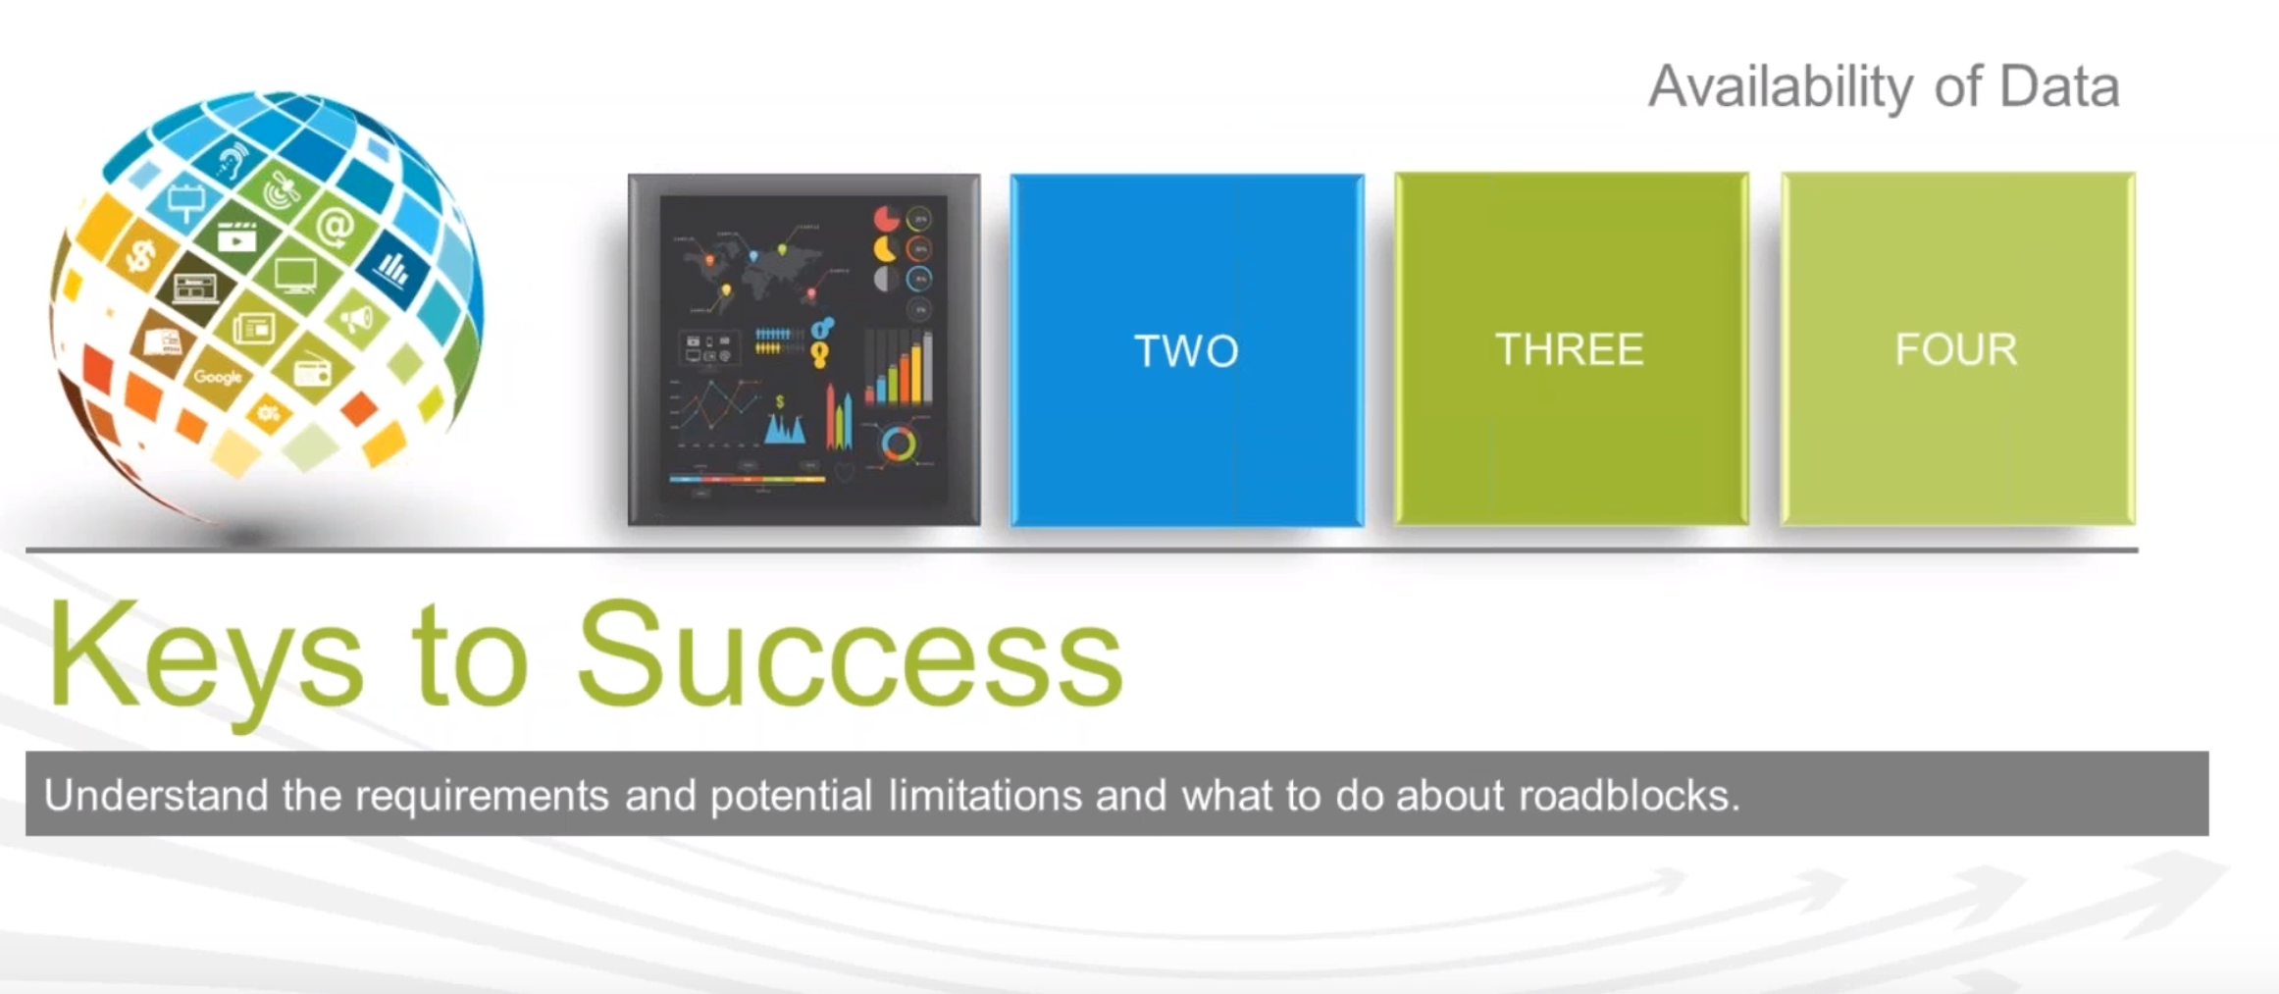

Slide 4
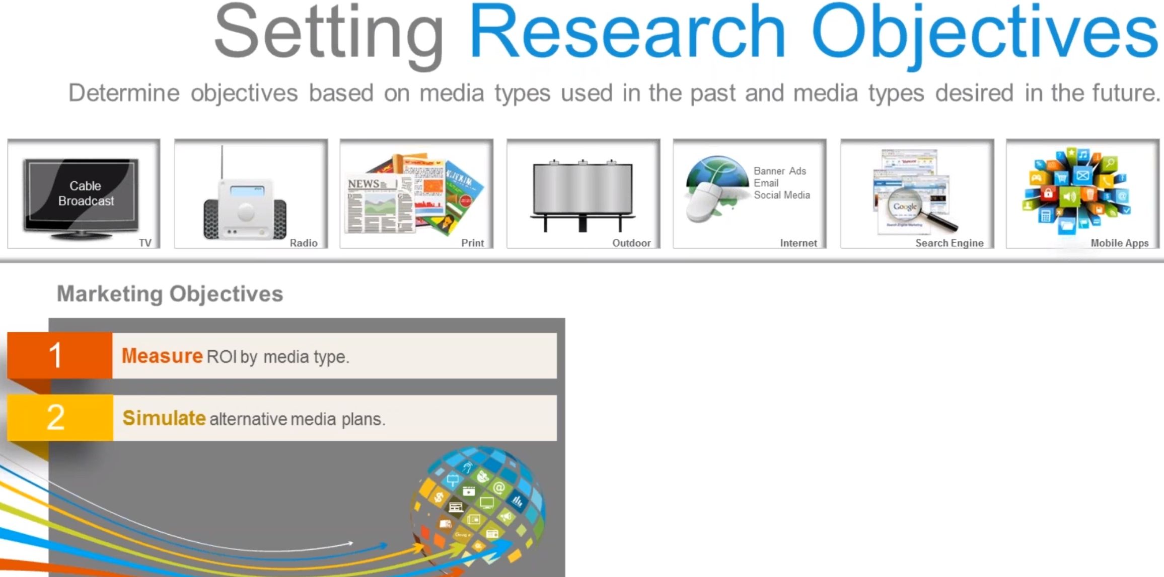

Slide 5
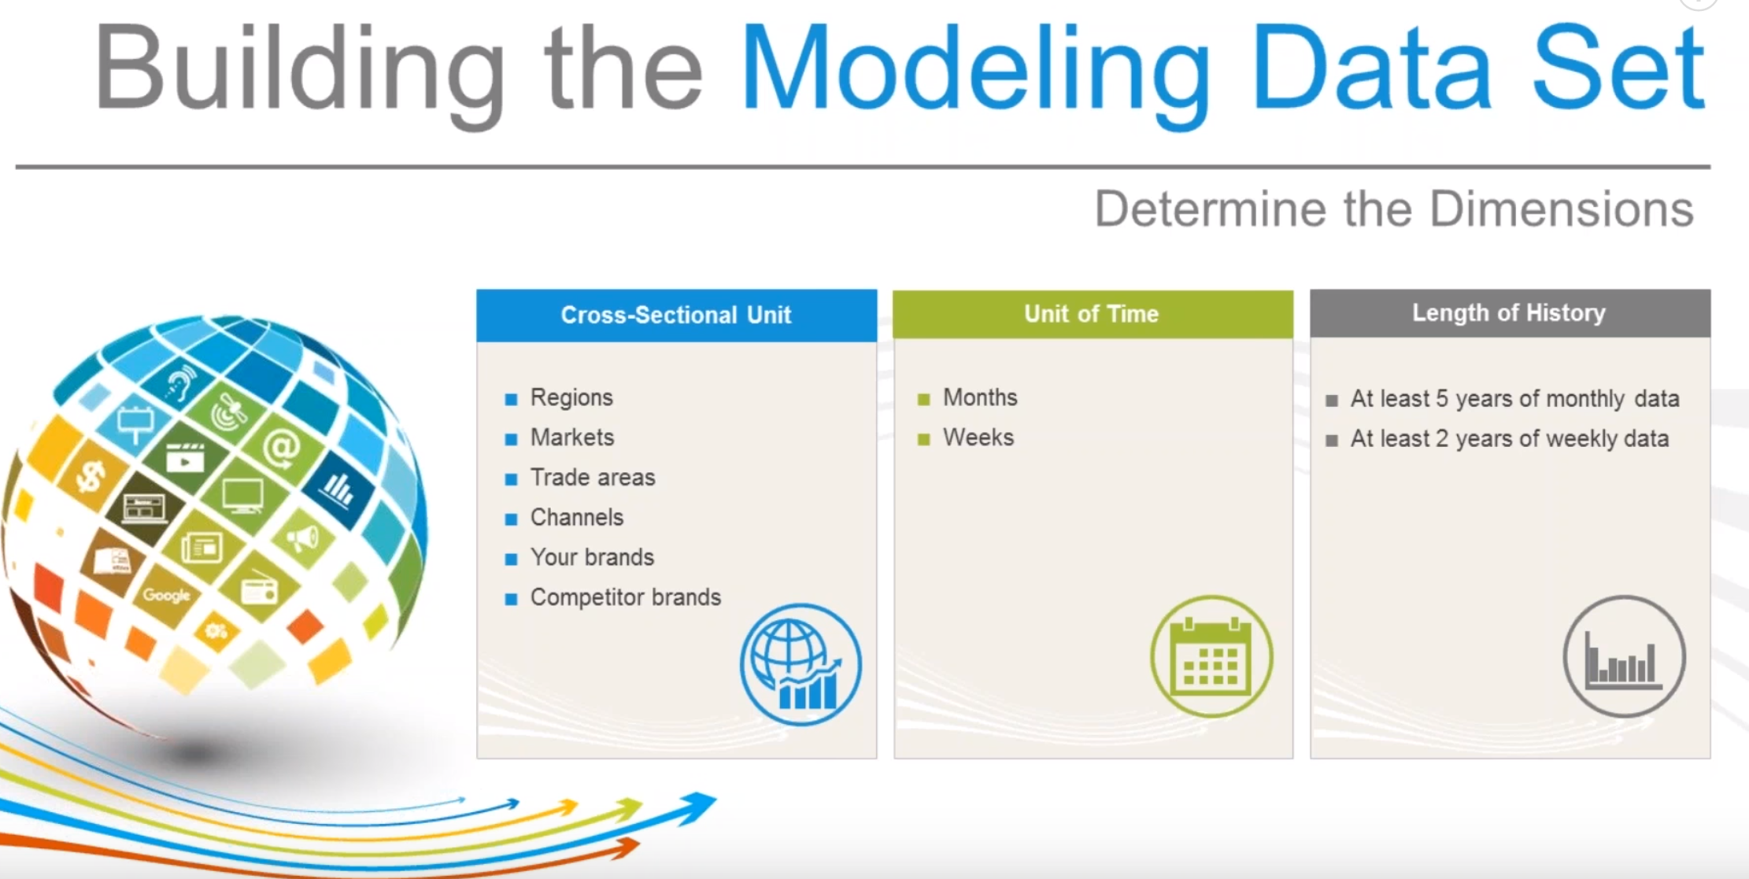

Slide 6
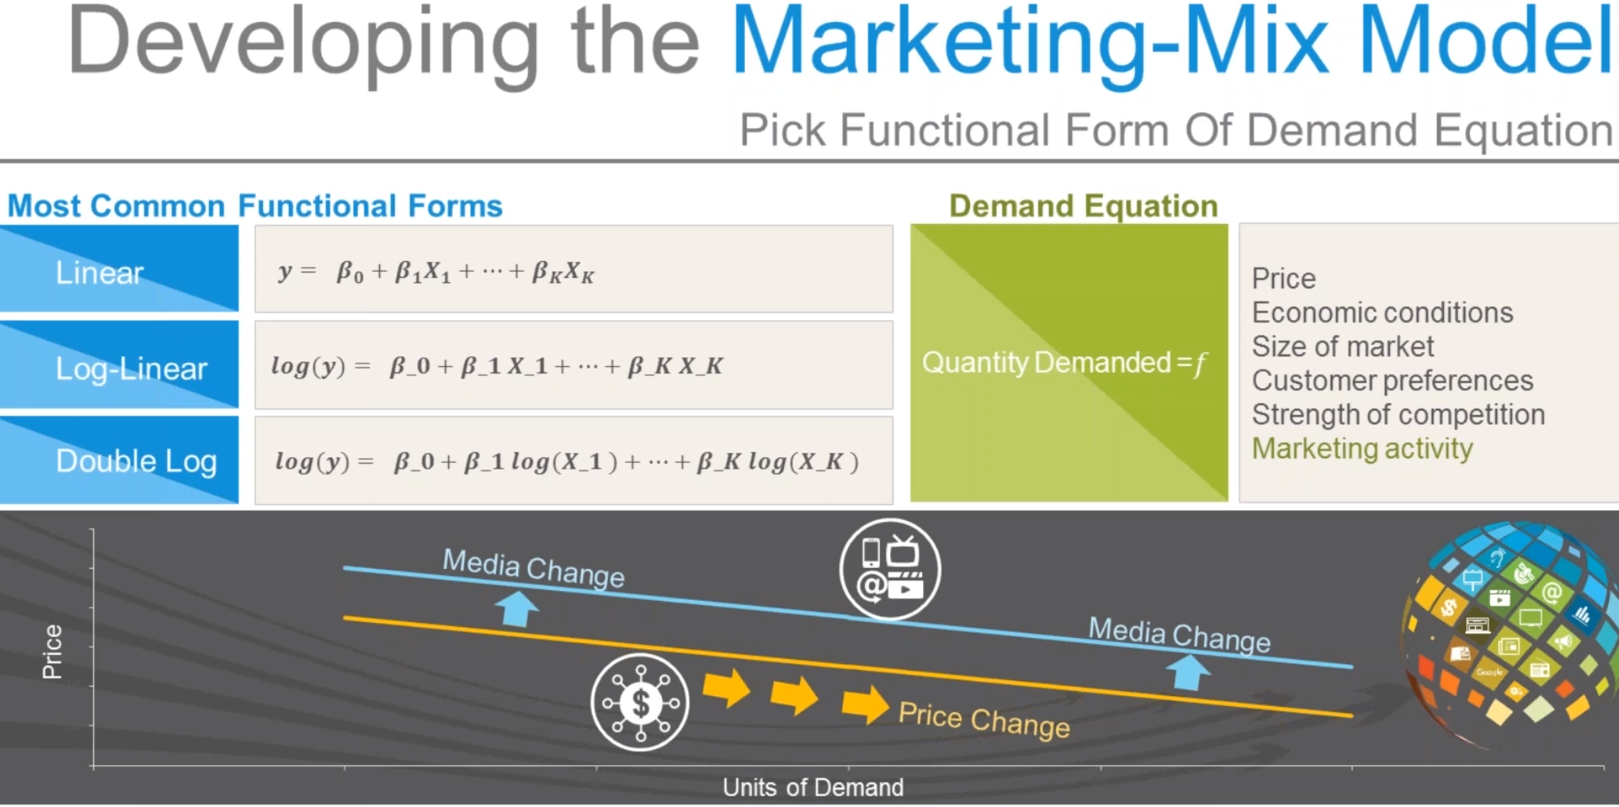

Slide 7
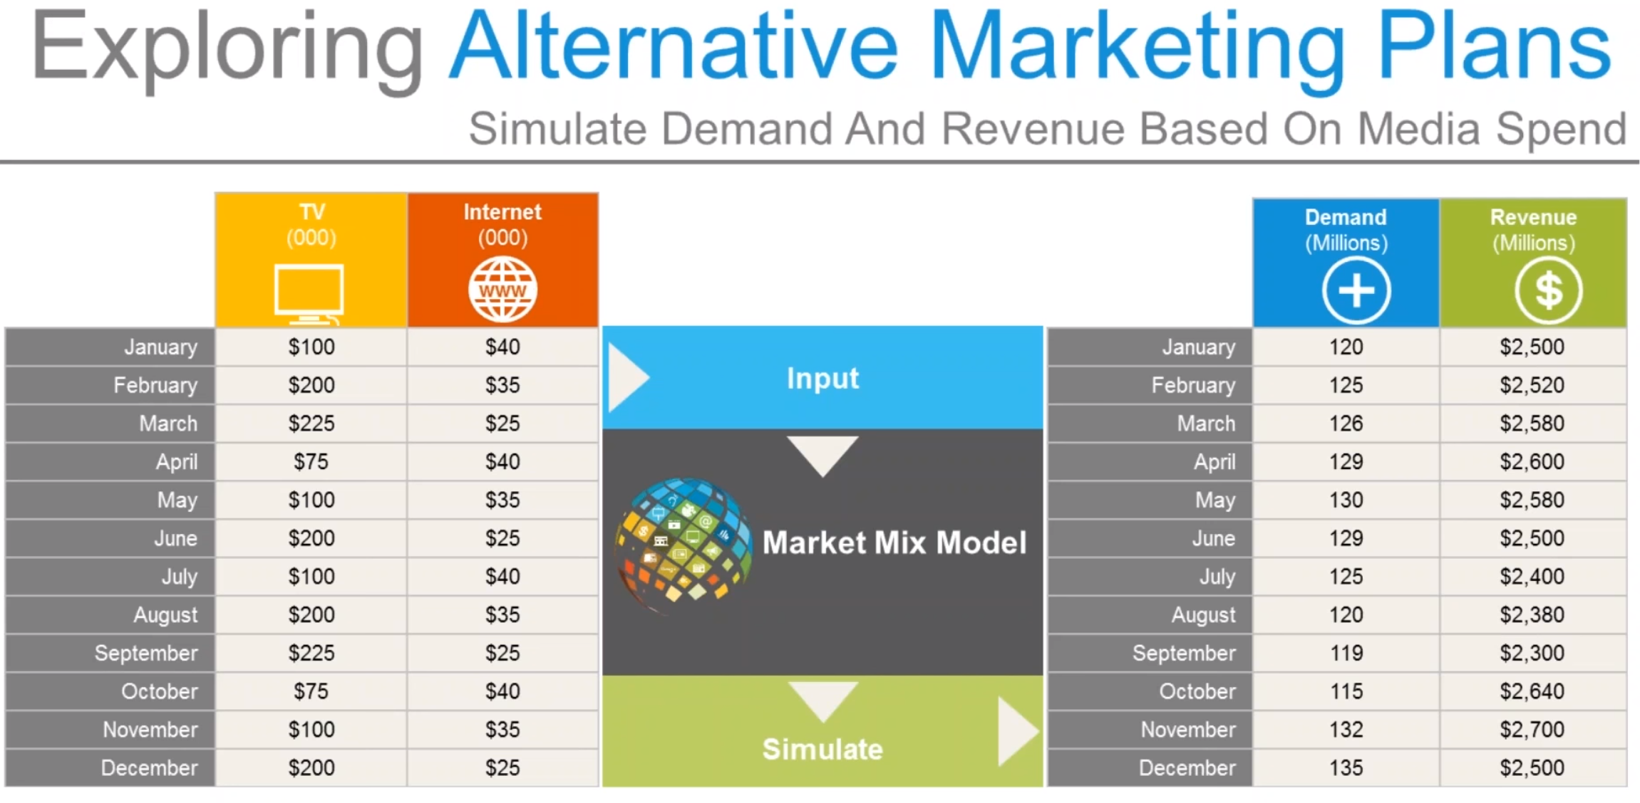

Slide 8
Thank You!

